Slide 1
Final Project
Mitchell Ford and Brent Hojer
Notes:
10+ slides
Design, Implementation, Features

Slide 2
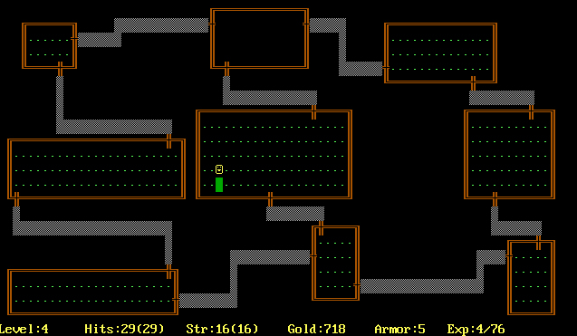
Chamber Crawler 3000
ChamberCrawler3000 (CC3k) is an assignment for CS students at the University of Waterloo developed by A. Roegiest and B. Lushman in 2013
CC3k is based on the DOS game Rogue, which was meant be to be a simple digital recreation of Dungeons and Dragons
The assignment document details what sort of features should be included but not how to implement or even how to go about designing them
My project will use Java with Swing graphics rather than C++ with ASCII graphics

Slide 3

“Modern” Graphics
Generic player/enemy
Shade
Drow
Vampire
Troll
Goblin
Human
Dwarf
Elf
Orc
“Dragon”
Halfling

Slide 4
Features of the Final Product
Launcher which allows for selection of player’s name and one of five races
The ability to explore user-created worlds by loading Floors from files
Movement using graphical controls
Combat with six unique enemy types
Object-oriented system of passive/on-hit/on-kill effects
Item system consisting of weapons, armor, and potions
Rudimentary artificial intelligence for enemies using fully modular Behavior objects
Fully functional character stat system akin to a watered down Dungeons and Dragons

Slide 5
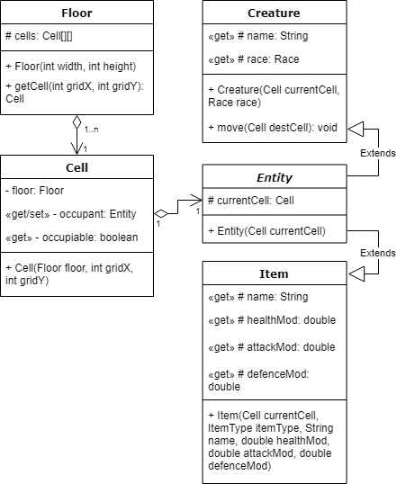
The Basic Design
Floor: contains a two-dimensional array of Cell objects
One of the highest Classes in the type hierarchy
Holds most of the game’s data
Cell: a container for an Entity object
Some may not be occupiable
Most operations will target the Cell rather than it’s occupying Entity
Entity: a Creature or an Item
Creatures can move
Items can be equipped by Creatures

Slide 6
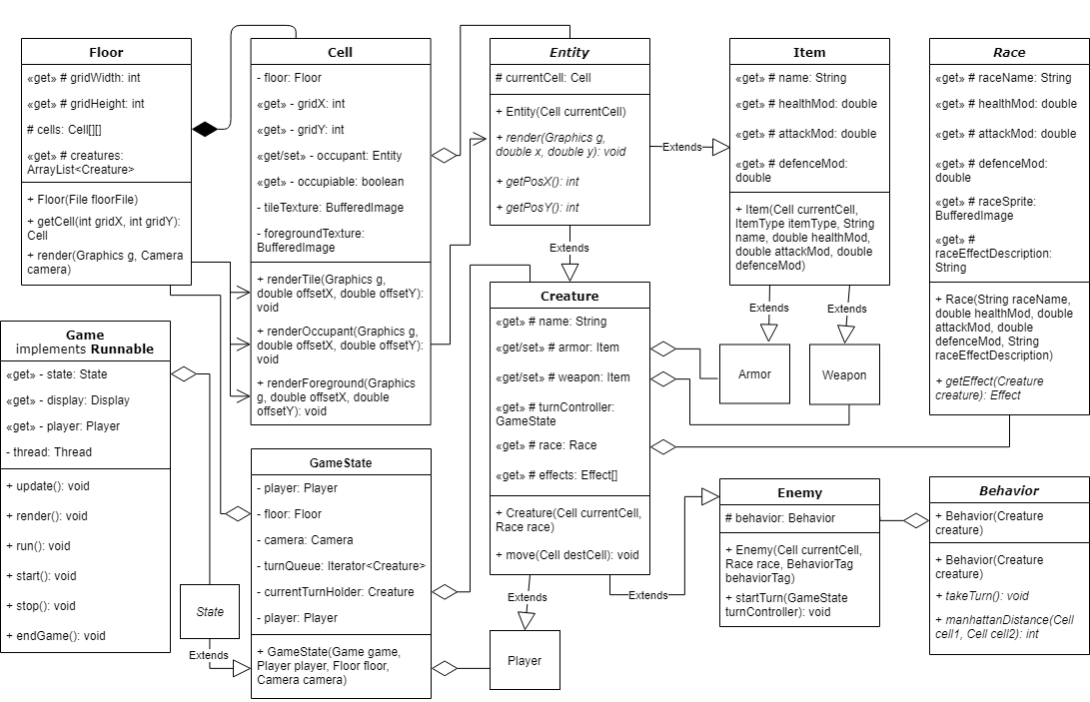
Core Class Design
Notes:
https://drive.google.com/file/d/1PH5OHl0A34yqoavTUkRqofprP8nocxBf/view?usp=sharing

Slide 7
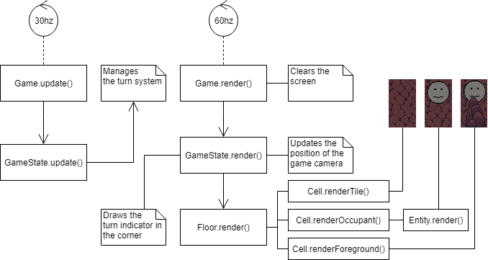
Core Systems Design
Notes:
https://drive.google.com/file/d/1PH5OHl0A34yqoavTUkRqofprP8nocxBf/view?usp=sharing

Slide 8
Core Systems Design
Graphical and gameplay systems are processed independently
This means what the user sees can be entirely separate from what is happening behind the scenes
Early builds of this program only had a picture of my friend Brandon to use as a graphic, but everything was fully functional
This program implements a common practice in game design: only rendering what the player should be able to see
This allows the computer to only have to do a small fraction of the rendering it otherwise would
This is essential in modern AAA games, but is only done here as a good practice considering the very small performance impact this game has to begin with
Camera objects have a member method called inViewPort(Cell) which returns true if the given Cell can be seen on screen
Notes:
https://drive.google.com/file/d/1PH5OHl0A34yqoavTUkRqofprP8nocxBf/view?usp=sharing

Slide 9

Floor Loading
Floors can be loaded in from Files
This allows for user created content
This slightly reduces the size of the .jar file, in case 100KB is too big
A proper Floor editor was planned but had to be cut for time
Microsoft Excel of Google Sheets allow for this functionality if you export as a .csv file and make some modifications
Ideally we would create levels using images rather than numbers
This is what a Floor file looks like, where the first four tokens are integers and the CELL tokens form a width x height grid
CELL tokens are replaced with either just an integer, corresponding to a Tile ID, or a Tile ID followed by a colon and another integer, corresponding to an Enemy ID or an Item ID

Slide 10
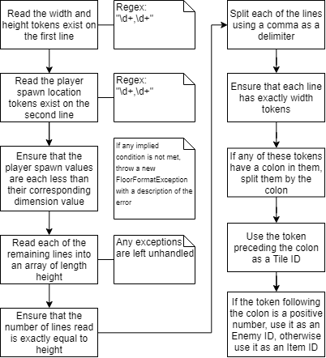
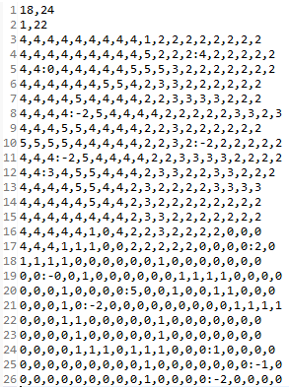
Floor Loading Algorithm & Example

